Slide 1
Data Analysis in Criminal Justice
Hypothesis Testing: Introduction

Slide 2
Statistical Inference with a Single Sample Mean
Logic of single sample inference
Steps in a hypothesis test

Slide 3

Logic of Single Sample Inference
Interval estimation and hypothesis testing represent two sides of the same coin
We use xbar to say something about $μ$
Interval estimation
Use xbar as a point estimate in order to estimate a plausible range of values for $μ$

Slide 4

Logic of Single-Sample Inference
Hypothesis testing
Make an assumption about what the true value of $μ$ is (sometimes we will know)
In the sampling distribution centered around $μ,$ where does xbar fall (i.e., how many $σ_{xbar}$ units)?
Is our assumption about $μ$ realistic (in a probabilistic sense), given the statistic that we obtain from our sample?

Slide 5

Question
Is it likely that our sample was drawn from a population with mean $μ$, or is our sample a subset of an entirely different population?
In other words, is $μ$ the mean of the sampling distribution that this sample mean came from?

Slide 6

Two Possible Answers
Yes, our sample was drawn from the population of interest
Observed difference between xbar and $μ$ is due to sampling error (i.e., chance difference)
No, our sample was drawn from a different population altogether
Observed difference between xbar and $μ$ is due to the fact that there are actually two different populations with two different means (i.e., systematic difference)

Slide 7

Single-Sample Inference
Inherently a probabilistic question
What is the probability we would obtain the observed sample mean if $μ$ was actually true?
Is the difference random or systematic?
Need to transform xbar and s from different samples into a common metric
z-score/t-score transformation

Slide 8

Intelligence & Crime
Research Question
Do offenders have lower IQ than the population?
IQ in the population: $μ$ = 100, $σ$ = 15
Sample of incarcerated offenders
n = 100
xbar = 94.1

Slide 9
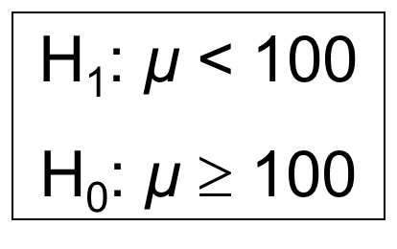

Steps in a Hypothesis Test
Step 1: Formally state hypotheses
Alternative (research) hypothesis ($H_{1}$)
Answer research question in the affirmative
Directional v. non-directional
Null hypothesis ($H_{0}$)
Answer research question in the negative

Slide 10

Steps in a Hypothesis Test (cont.)
Step 2: Obtain a probability distribution
If $H_{0}$ is true: we expect xbar to lie relatively close to hypothesized $μ$ (i.e., near the center)
If $H_{0}$ is false: we expect xbar to lie far away from hypothesized $μ$ (i.e., in the tail)
Is $σ$ known or unknown?

Slide 11
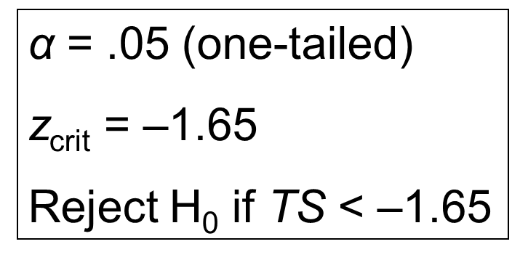
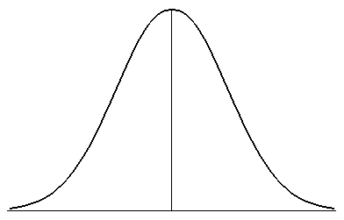

Steps in a Hypothesis Test (cont.)
Step 3: Make decision rules
Level of significance ($α$): one v. two tailed
Critical value and rejection region
How many standard error units away?

Slide 12
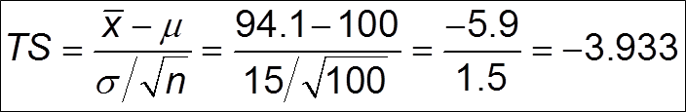

Steps in a Hypothesis Test (cont.)
Step 4: Calculate the test statistic (TS)
Standard score for a mean ($σ$ known)
What does this mean?

Slide 13
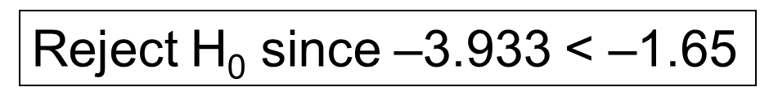

Steps in a Hypothesis Test (cont.)
Step 5: Make a decision about the null hyp
If TS is in rejection region, reject null
If TS is in acceptance region, accept null
Conclusion: $μ$ < 100 for offenders
Offenders have significantly lower IQ than the general population

Slide 14
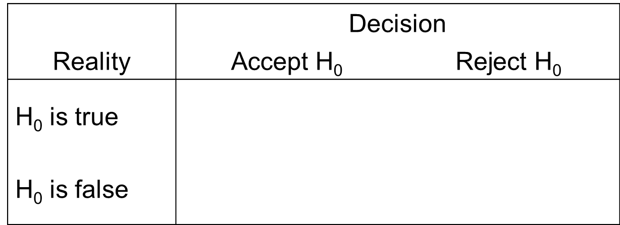
Potential Errors
Type I Error =
Type II Error =

Slide 15

Type I & Type II Errors
Type I error reduced by decreasing level of significance ($α$)
Errors inversely related
↓ p(type I error), ↑ p(type II error)
↓ p(type II error), ↑ p(type I error)

Slide 16
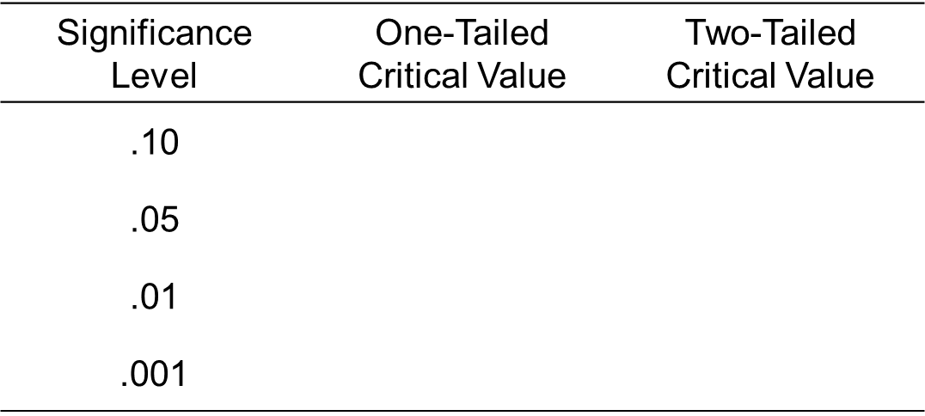

Critical z-Scores
$z_{crit}$ for hypothesis testing

Slide 17

Minneapolis Crime Hot Spots
Calls to police for all addresses and intersections (“places”) in 1986
$μ$ = 2.82 ($σ$ = 2.31)
n = 3795 high-risk places
xbar = 43.03
Research question
Do high-risk areas make more calls to the police than the general population?

Slide 18
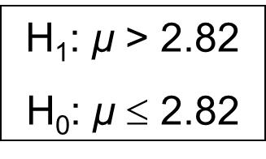
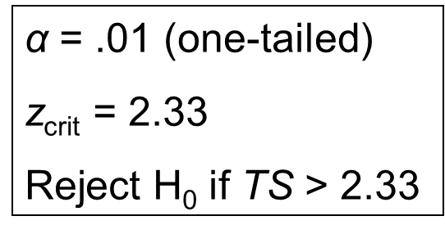
Minn. Crime Hot Spots (cont.)
Step 1: Formally state hypotheses
Step 2: Obtain a probability distribution
z-distribution
Step 3: Make decision rules

Slide 19
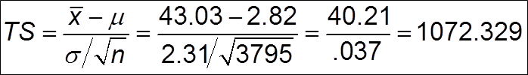
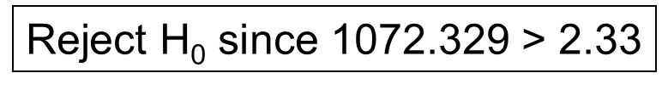

Minn. Crime Hot Spots (cont.)
Step 4: Calculate the test statistic
Step 5: Make a decision about the null hypothesis
Conclusion: $μ$ > 2.82
There are significantly more calls to the police in high-risk places

Slide 20

U.S. Homicide Rates
Homicide rate per 100,000 since 1950
$μ$ = 7.11 ($σ$ = 2.03)
n = 50 states in 2001
xbar = 5.6
Research Question
Has there been a change from the average homicide rate over the last 50 years?

Slide 21
U.S. Homicide Rates (cont.)
Step 1: Formally state hypotheses
Step 2: Obtain a probability distribution
Step 3: Make decision rules

Slide 22
U.S. Homicide Rates (cont.)
Step 4: Calculate the test statistic
Step 5: Make a decision about the null hypothesis

Slide 23

Unknown Population SD
When we don’t know $σ$, we must estimate using s
Since we have to estimate this additional parameter, we have additional sampling error
Adjust for “degrees of freedom”
df = n - 1

Slide 24

Unknown Population SD (cont.)
New test statistic when $σ$ is unknown
$TS= \frac{xbar − μ}{\frac{s}{\sqrt{n −1}}}$
Probability distribution is “t” instead of “z”

Slide 25

Training School
Do training school youths offend more than non-training school youths?
$μ$ = .75, n = 121, xbar = 2.25 (s² = 12.51)

Slide 26

Prosocial Activities
Do boot camp youths engage in fewer prosocial activities than other youths?
$μ$ = 2.21, n = 10, xbar = 1.53 (s = 2.21)

Slide 27

Child Maltreatment
Is there an association between child abuse and arrest?
$μ$ = 1.25, n = 61, xbar = 2.57 (s = 2.81)

Slide 28
Data Analysis in Criminal Justice
Hypothesis Testing with Two Categorical Variables (Chi-Square)

Slide 29
Inference with Two Categorical Variables
Contingency tables
Chi-square test of independence
Measures of association

Slide 30
Contingency Tables
Contingency table
Joint distribution of two variables
Defined by number of rows and number of columns (R X C)

Slide 31
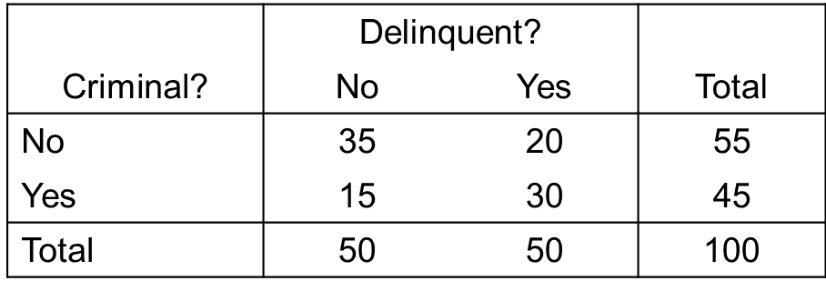
Contingency Tables (cont.)
Example: juvenile and adult arrests
2 X 2 contingency table
Is adult arrest independent of juvenile arrest, in other words, does knowing that someone was arrested as a juvenile help us predict whether they are arrested as an adult?

Slide 32
Conditional Probabilities
Method #1: conditional probabilities
p(C|~D) =
p(C|D) =
Are juvenile and adult arrest independent?

Slide 33
Expected Frequencies
Method #2: expected frequencies
Comparison of observed frequencies with expected frequencies under the assumption of independence
Multiplication rule of independence
p(A ∩ B) = p(A)×p(B)

Slide 34
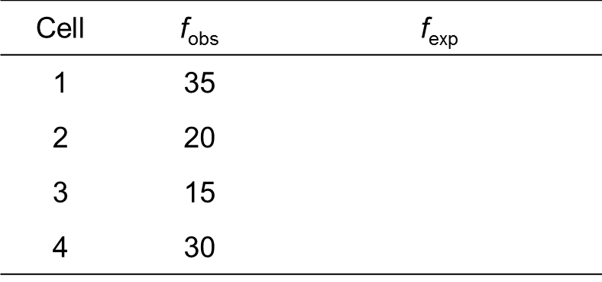

Expected Frequencies (cont.)
Computing expected frequencies

Slide 35
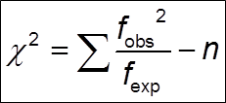

Chi-Square
Method#3: chi-square test of independence
Formal test of whether two categorical variables are statistically independent
Comparison of observed and expected frequencies
Probability distribution is $χ^{2}$
df = (# rows – 1)(# columns – 1)

Slide 36
Juvenile & Adult Crime
Research question
Is juvenile arrest a predictor of adult arrest?
Step 1: Formally state hypotheses
Step 2: Obtain a probability distribution
Step 3: Make decision rules

Slide 37
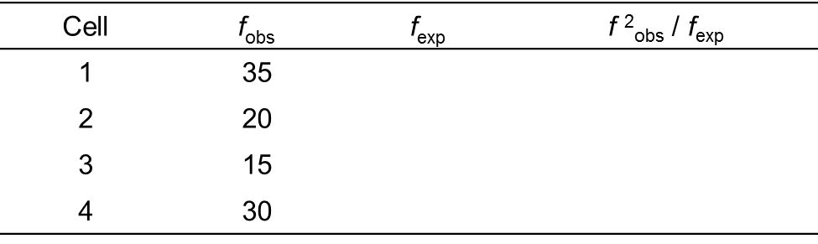
Juvenile & Adult Crime (cont.)
Step 4: Calculate the test statistic
Step 5: Make a decision about the null hypothesis

Slide 38
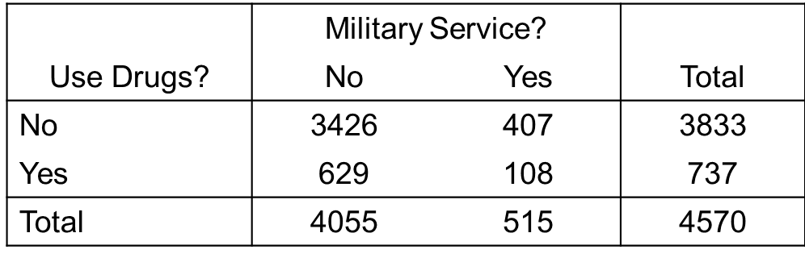
Military Service & Drug Use
p(D|~M) =
p(D|M) =
Research Question
Is there a relationship between military service and drug use?

Slide 39
Military Service & Drug Use (cont.)
Step 1: Formally state hypotheses
Step 2: Obtain a probability distribution
Step 3: Make decision rules

Slide 40
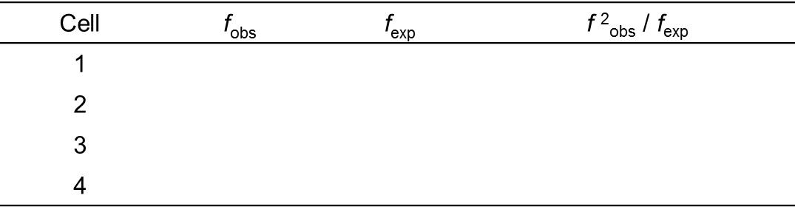
Military Service & Drug Use (cont.)
Step 4: Calculate the test statistic
Step 5: Make a decision about the null hypothesis

Slide 41
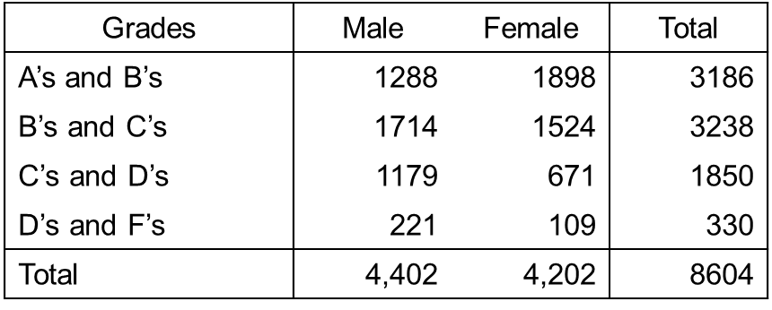
Gender & School Performance
Research Question
Is there a relationship between gender and school performance?

Slide 42
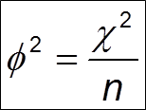
Measure of Association
χ² tells us if the relationship is statistically significant
Measures of association tell us if the relationship is substantively significant
Phi-square
Can only be computed with a 2 X 2 table

Slide 43
Phi-Square
Juvenile arrest and adult arrest
Military service and drug use
“Explained variance” interpretation

